Slide 1
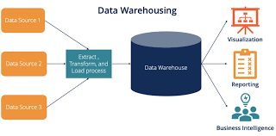
Introduction to Warehouses
Data Warehouse and DBMS Architecture of Data Warehouse, Multidimensional data model
Concepts of OLAP and Data Cube
OLAP operations
Dimensional Data Modelling- Star, Snow flake schemas

Slide 2
What is Data Warehouse
A decision support database that is maintained separately from the organization’s operational database
Support information processing by providing a solid platform of consolidated, historical data for analysis.
A data warehouse is a Subject-oriented, integrated, time-variant, and non-volatile collection of data in support of management’s decision-making process

Slide 3
Subject-oriented –
Organized around major subjects, such as customer, supplier, product sales atc.
Provide a simple and concise view around particular subject issues by excluding data that is not useful for decision process
Modeled in accordance with decision makers needs and not transaction processing needs

Slide 4
Integrated –
Constructed by integrating multiple, heterogeneous data sources- relational databases, flat files, on-line transaction records
Data cleaning and data integration techniques are applied.
Ensure consistency in naming conventions, encoding structures, attribute measures, etc. among different data sources

Slide 5
Time-variant : The time horizon for the data warehouse is significantly longer than that of operational systems
Operational database: current value data
Data warehouse data: provide information from a historical perspective (e.g., past 5-10 years)
Every key structure in the data warehouse Contains an element of time, explicitly or implicitly
key of operational data may or may not contain “time element”

Slide 6
Non-volatile
A physically separate store of data transformed from the operational environment
Operational update of data does not occur in the data warehouse environment
Does not require transaction processing, recovery, and concurrency control mechanisms
Requires only two operations in data accessing: initial loading of data and access of data

Slide 7
What is Data Warehousing
The process of constructing and using data warehouses

Slide 8
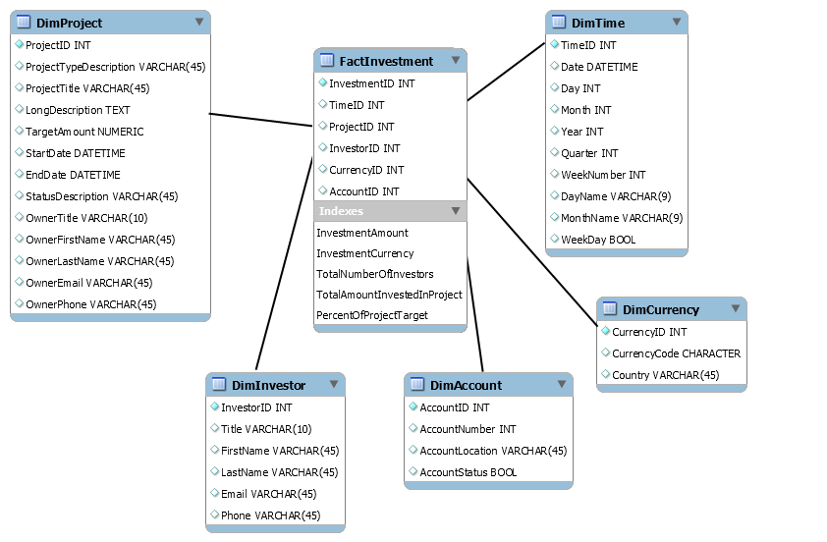
Example of data warehouse

Slide 9
OLTP
The major task of online operational database systems is to perform online transaction and query processing.
These systems are called online transaction processing(OLTP) systems.
They cover most of the day-to-day operations of an organization such as purchasing, inventory, manufacturing, banking, payroll, registration, and accounting.

Slide 10
OLAP
Data warehouse systems, on the other hand, serve users or knowledge workers in the role of data analysis and decision making.
Such systems can organize and present data in various formats in order to accommodate the diverse needs of different users.
These systems are known as online analytical processing (OLAP) systems.

Slide 11
Distinct features (OLTP vs. OLAP):
User and system orientation: customer vs. market
Data contents: current, detailed vs. historical, consolidated
Database design: ER + application vs. star + subject
View: current, local vs. evolutionary, integrated
Access patterns: update vs. read-only but complex queries

Slide 12
OLTP
OLAP
users
clerk, IT professional
knowledge worker
function
day to day operations
decision support
DB design
application
-
oriented
subject
-
oriented
data
current, up
-
to
-
date
historical,
detailed, flat relational
summarized, multidimensional
isolated
integrated, consolidated
usage
repetitive
ad
-
hoc
access
read/write
lots of scans
index/hash on prim. key
unit of work
short, simple transaction
complex query
# records accessed
tens
millions
#users
thousands
hundreds
DB size
100MB
-
GB
100GB
-
TB
met
ric
transaction throughput
query throughput, response

Slide 13
Data Warehouse –Data Model? (4.2.1)
A data warehouse views data in the form of a data cube
A data cube allows data to be modeled and viewed in multiple dimensions. It is defined by dimensions and facts.
For example, AllElectronics may create a sales data warehouse in order to keep records of the store’s sales with respect to the dimensions time, item, branch, and location.
Facts are numeric measures. Think of them as the quantities by which we want to analyze relationships between dimensions.
Examples of facts for a sales data warehouse include dollars sold (sales amount in dollars), units sold (number of units sold), and amount budgeted.
The fact table contains the names of the facts, or measures, as well as keys to each of the related dimension tables.

Slide 14
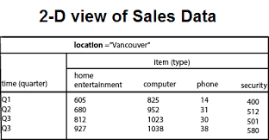
Data representation
2-D View of Sales Data for AllElectronics According to time and item

Slide 15
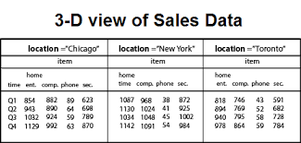
Data representation
3-D View of Sales Data for AllElectronics According to time, item, and location

Slide 16
Data representation
3-D View of Sales Data for AllElectronics According to time, item, and location

Slide 17
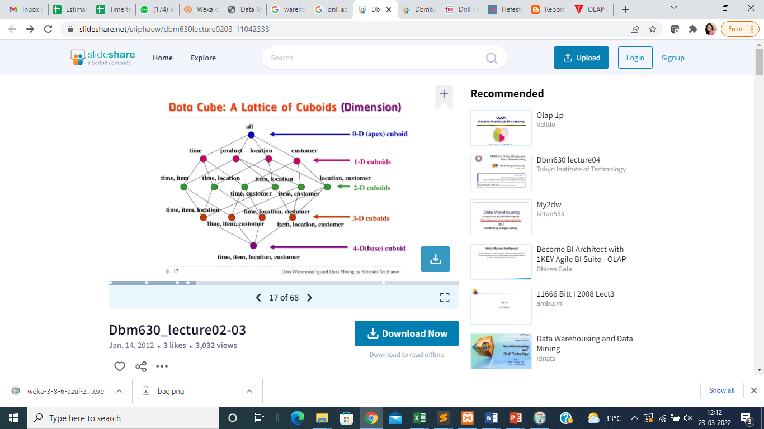
Cube: a lattice of cuboids:
Data Mining And Data Warehousing By Dr. Mrs. S. C. Shirwaikar

Slide 18
Given a set of dimensions, we can generate a cuboid for each of the possible subsets of the given dimensions.
The result would form a lattice of cuboids, each showing the data at a different level of summarization, or group-by.
The lattice of cuboids is then referred to as a data cube
An n-D base cube is called a base cuboid.
The top most 0-D cuboid, which holds the highest-level of summarization, is called the apex cuboid.

Slide 19
Typical OLAP operations
Multidimensional data model provides users with the flexibility to view data from different perspectives.
OLAP operations on data cubes results into different views of data, allowing interactive queries and search of the record at hand.

Slide 20
OLAP Operations : Roll up
summarize data by climbing up hierarchy or by dimension reduction

Slide 21
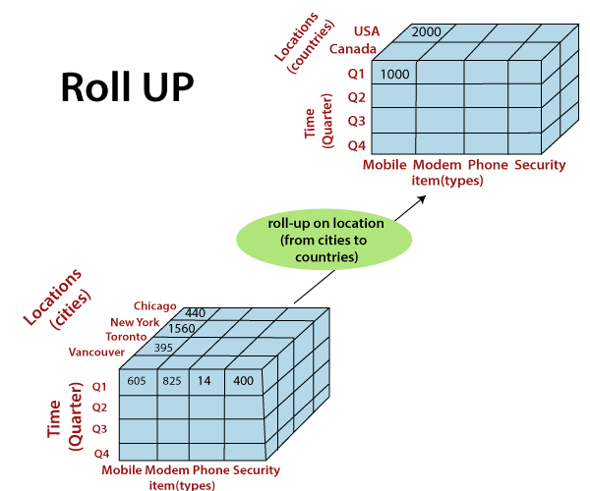
OLAP Operations : Roll up/Drill up
Summarize data by climbing up
hierarchy or by dimension reduction
Ex. This hierarchy was defined as the total order “street < city < province or state < country.”
The roll-up operation shown aggregates the data by ascending the location hierarchy from the level of city to the level of country

Slide 22
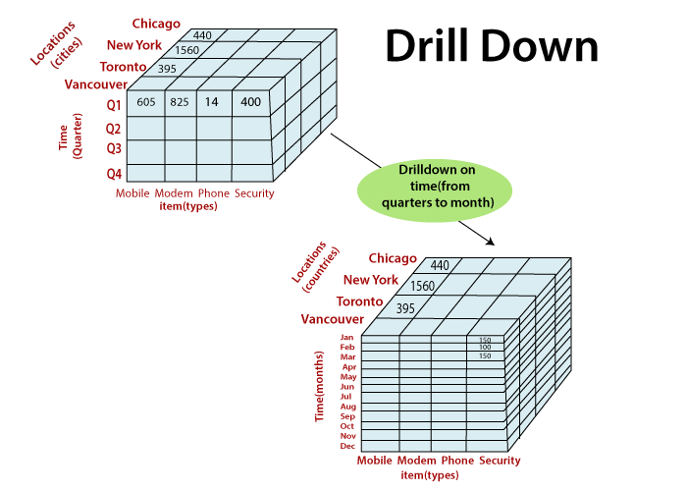
OLAP Operations : Drill Down
Drill-down can be realized by either stepping down a concept hierarchy for a dimension or introducing additional dimensions
Ex. This hierarchy was defined as the total order concept hierarchy for time defined as “day < month < quarter < year.”
Drill-down occurs by descending the time hierarchy from the level of quarter to the more detailed level of month.

Slide 24
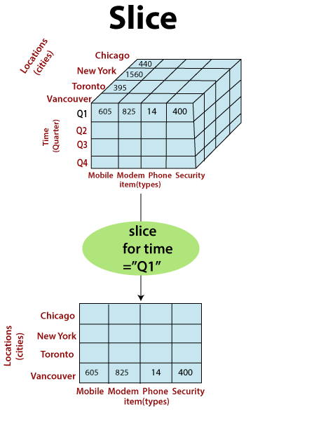
OLAP Operations : Slice
The slice operation performs a selection on one dimension of the given cube, resulting in a subcube
Ex. slice operation where the sales data are selected from the central cube for the dimension time using the criterion time = “Q1.”

Slide 25
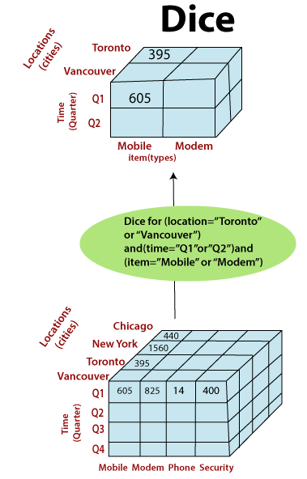
OLAP Operations : Dice
The dice operation defines a subcube by performing a selection on two or more dimensions.
Dice operation on the central cube based on the following selection criteria that involve three dimensions: (location = “Toronto”or “Vancouver”) and (time = “Q1” or “Q2”) and (item = “home entertainment” or“computer”).

Slide 27
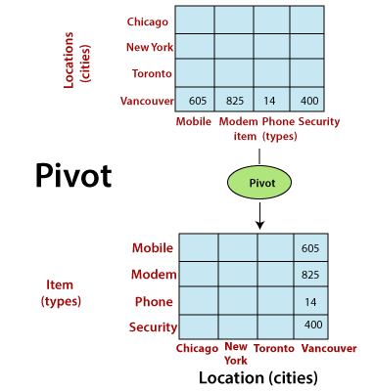
OLAP Operations : Pivot (rotate)
Pivot (also called rotate) is a visualization operation that rotates the data axes in view to provide an alternative data presentation.
shows a pivot operation where the item and location axes in a 2-D slice are rotated.

Slide 28
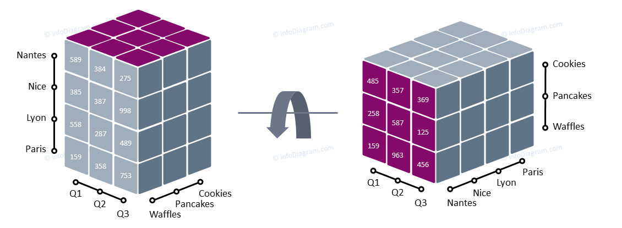

Slide 29
OLAP Operations : Pivot (rotate)
Pivot (also called rotate) is a visualization operation that rotates the data axes in view to provide an alternative data presentation.
shows a pivot operation where the item and location axes in a 2-D slice are rotated.

Slide 30
Conceptual Modeling of Relational Data Model
Example:
If we want to create exam database. Student will appear for the exam. Student can attempt only one or more exam. But one exam can be given by many students.
To store information for above we will required a database. To design database for above scenario ,we have to find out the entities and relationship among them.
Entities will be: Student and exam
Relationship will be: Student appears for exam
We can represent above structure using ER Model as
1
m
Student
Appear
Exam

Slide 31
Using above diagram It is clear that ,database will contain data for student and exam.
RollNO | Student_Name | Contact | Address
1 | Punam | 325345 | Pune
2 | Nilima | 435443 | Mumbai
3 | Divya | 435443 | Pune
4 | Kalyani | 325345 | Mumbai
5
RollNo | Exam_Id | Date | Marks
1 | 101 | 12/02/2016 | 65
3 | 102 | 12/02/2016 | 44
4 | 103 | 12/02/2015 | 56
2 | 104 | 12/02/2016 | 67
1 | 103 | 12/02/2015 | 87
Student
Exam

Slide 32
Conceptual Modelling of Data warehouses
Design Decisions
Choosing the process – selecting the subjects for the first set of logical structures to be designed
Ex. Student, Uniesrity,Sports etc.
Choosing the grain- determining the level of detail for the data in the data structures
Identifying and conforming the dimensions- choosing the dimensions to be included
Ex. Dimensions
Time , location , item , branch
Choosing the facts-Selecting the metrics or units of measurements to be included
Facts
Quantity of sales, Sales Amount
Choosing the duration of the database- determining how far back in time one should go for historical data

Slide 33
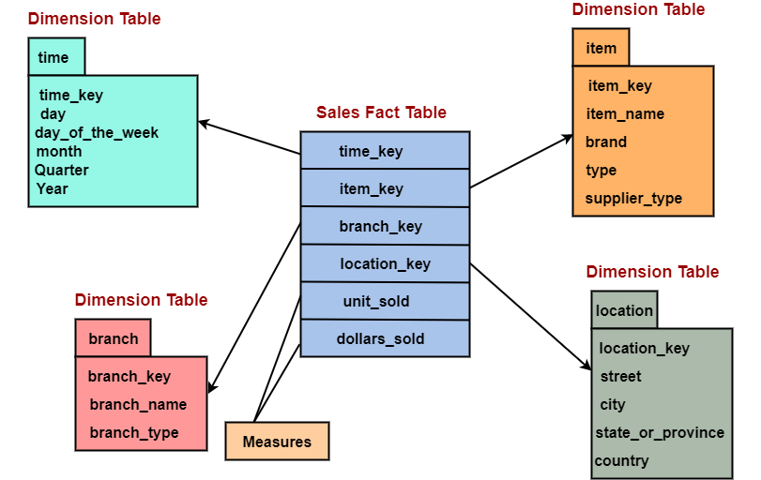

Slide 34
Conceptual Modelling of Data warehouses
The model should provide the best data access
The whole model should be queri-centric
It must be optimized for queries and analysis
It must be structured in such a way that every dimension can interact equally with the fact table
The model should allow drilling down or rolling up along dimension hierarchies

Slide 35
Schemas for multidimensional data models (4.2.2)
The most popular data model for a data warehouse is a multidimensional model, which can exist in the form of
A star schema
A snowflake schema,
A fact constellation schema.

Slide 36
A star schema
In star schema data warehouse contains
1. a large central table (fact table) containing the bulk of the data, with no redundancy
2. a set of smaller attendant tables (dimension tables), one for each dimension.
Dimension 3
Dimension 4
Dimension 1
Facts
Dimension 2
Dimension 5

Slide 37
A star schema
In star schema data warehouse contains
1. a large central table (fact table) containing the bulk of the data, with no redundancy
2. a set of smaller attendant tables (dimension tables), one for each dimension.
Dimension 3
Dimension 4
Dimension 1
Facts
Dimension 2
Dimension 5

Slide 38
Example of Star Schema
time
time_key
day
day_of_the_week
month
quarter
year
item
item_key
item_name
brand
type
supplier_type
Sales Fact Table
time_key
item_key
branch_key
branch
location
location_key
branch_key
branch_name
branch_type
location_key
street
city
state_or_province
country
units_sold
dollars_sold
avg_sales
Measures

Slide 39
location
Camp pune mh india
Kothrud pune mh india
pune station pune mh india
location_key
street
city
state_or_province
country

Slide 40
STAR SCHEMA KEYS
Avoid built-in meanings in the primary key of the dimension table
Do not use operational system keys as primary keys
Operational system keys contain built in meaning
The keys may be reassigned, thus giving wrong aggregate value
Use keys which are system generated sequence numbers
The operational system keys can be stored as attributes in dimension table.

Slide 41
Advantages of Star Schema
The star schema reflects exactly the way the decision makers thinks in terms of business metrics.
Users understand the structures very easily
It optimizes navigation through the database
It is most suitable for query processing
It allows query processor software to use better execution plans
Disadvantages of Star Schema
Dimension tables are not normalized leading to redundancy and inconsistency

Slide 42
The snowflake schema is a variant of the star schema model(4.6)
The snowflake schema is a variant of the star schema model
some dimension tables are normalized, thereby further splitting the data into additional tables
The resulting schema graph forms a shape similar to a snowflake
Ex. The item and location dimensions have been normalized to give rise to two more tables supplier and city

Slide 43
Example of Snowflake Schema
supplier
supplier_key
supplier_type
item
time
item_key
item_name
brand
Type
supplier_type
supplier_key
time_key
day
day_of_the_week
month
quarter
year
Sales Fact Table
time_key
city
item_key
city_key
city
state_or_province
country
branch_key
branch
location_key
branch_key
branch_name
branch_type
units_sold
location
location_key
street
City_key
dollars_sold
avg_sales
Measures

Slide 44
Advantages of Snowflake Schema
Small savings in storage space.
Normalized structures are easier to update and maintain
Disadvantages of Snowflake Schema
Schema is less intuitive and end-users are affected by the complexity
Difficult to browse through contents
Degraded query performance because of additional joins

Slide 45
Fact constellation.
A fact constellation schema allows dimension tables to be shared between fact tables
For example, the dimensions tables for time, item, and location are
shared between the sales and shipping fact tables.

Slide 46
shipper
item
shipper_key
shipper_name
location_key
shipper_type
item_key
item_name
brand
type
supplier_type
time
Sales Fact Table
time_key
day
day_of_the_week
month
quarter
year
time_key
Shipping Fact Table
Sales Fact Table
time_key
item_key
Sales Fact Table
item_key
branch_key
shipper_key
location_key
From_location
branch
units_sold
To_Location
branch_key
branch_name
branch_type
dollars_sold
dollars_cost
avg_sales
location
location_key
Street
city
state_or_province
country
units_shiped
Measures

Slide 47
Inside a dimension table
Dimension table key- Primary key that uniquely identifies rows in the table
Table is wide-has many columns or attributes
Fewer number of records- fewer rows than fact table-dimension table in hundreds –facts in millions
Textual attributes- attributes are of textual format-they represent textual descriptions of a business dimension

Slide 48
Inside a dimension table
Attributes not directly related-Some attributes are not related to one another such as brand and supplier_type in item dimension table but both are attributes of item
Not Normalized- For efficient query performance
Multiple Hierarchies- Dimension tables often provide for multiple hierarchies so that drilling down may be performed along any of the multiple hierarchies

Slide 49
Inside a Fact table
Fully Additive measures These are the measures that can be summed up across all the the dimensions.
Ex. Units_sold is fully additive measure because we can add up units_sold across all the dimensions items, location,branch
Semi Additive measures- Semi additive measures are measures that can be summed up across some dimensions but not all.
Ex.dollars earned per quantity.
Table deep, not wide- Fact tables typically contain measures and foreign keys to dimension tables, resulting in deeper tables with more rows
Fact table is spread vertically while dimension table is spread horizontally

Slide 50
Inside a Fact table
Sparse data-Sparse data refers to situations where not every combination of dimension attributes has a corresponding entry in the fact table.
Degenerate dimensions- these are some attributes such sales_order_no which appear in fact table though these are not measures also not associated with any dimension.

Slide 51
The Factless fact Table
Apart from Concatenated primary keys a fact table do not contains facts or measures.
Ex. The fact table for analyzing student attendance with possible dimensions as student course, professor, room and date.
Date Key
Course Key
Professor Key
Student Key
Room Key
Date Dimension
Professor Dimension
Course Dimension
Room Dimension
Student Dimension
The presence of a fact table entry itself indicates attendance. Fact table represents events

Slide 52
Revision questions
1. Define data warehouse
2. Explain OLTP and OLAP
3. Compare OLAP and OLTP
4. State and explain OLAP operations
5.Explain star model
6.Explain snowflake mode
7.Explain fact constellation model
8.Breif fact table and dimension table
9 discuss the concept of factless fat table

